Slide 1
Internal Sharing – Data Flow
Data flow - OnPrem Mapping services - AWS Simple Storage Services Glue catalog/crawler
Athena Practice

Slide 2
Internal Sharing – Data Flow
- Data flow - OnPrem - Mapping services - AWS - Simple Storage Services - Glue catalog/crawler.
- Athena. - Practice:

Slide 3
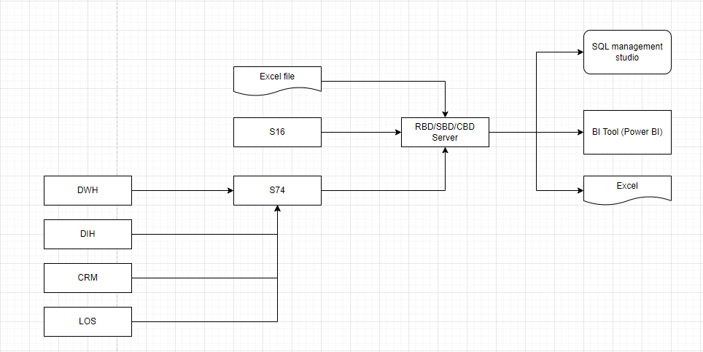
Data flow - OnPrem
Athena de tong hop cac file va query nhu tren db nhung khong phai la db that
ssis/ glue, EMR
ec2

Slide 4
Internal Sharing – Data Flow
- Data flow - OnPrem - Mapping services - AWS - Simple Storage Services - Glue catalog/crawler.
- Athena. - Practice:

Slide 5
Mapping services - AWS
EC2 -- sever
Glue -- etl du lieu
RDS -- tuong ung sql sever
Redshift -- tuong ung dwh
Athena -- phân tích tương tác phi máy chủ -- khai thac tren file khong qua data base
Quicksight -- bi tool
Event Bridge
SNS
Pyspark/Python

Slide 6
Internal Sharing – Data Flow
- Data flow - OnPrem - Mapping services - AWS - Simple Storage Services (S3)– dich vu luu tru - Glue catalog/crawler.
- Athena. - Cost estimation. - Practice:

Slide 7
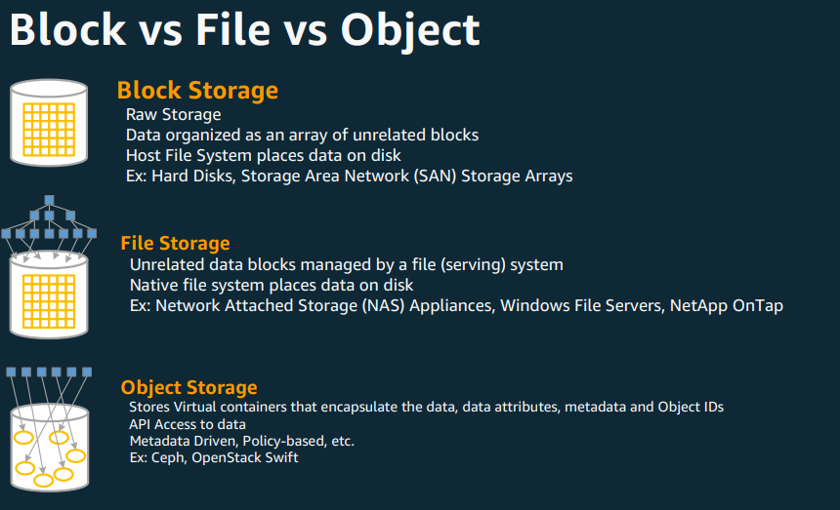
Block vs File vs Object

Slide 8
Simple Storage Services – S3 (1)
Object store
Highly durable (99.999999999% design) – rui ro thap
Limitlessly scalable – dung luong khog gioi han
Multiple Tiers to match your workload
Data Lifecycle Rules --
Static Website Hosting
Security, Compliance, and Audit capabilities
Standard Storage Pricing (us-east-1) - $0.023 per GB

Slide 9
Internal Sharing – Data Flow
- Data flow - OnPrem - Mapping services - AWS - Simple Storage Services - Glue catalog/crawler.
- Athena. - Cost estimation. - Practice:

Slide 10
Glue - Crawler
Automatically build your Data Catalog and keep it in sync
Automatically discover new data, extract definitions
Run ad-hoc or on schedule
The output of the Crawler consists of one or more metadata tables
Pay when crawler runs

Slide 11
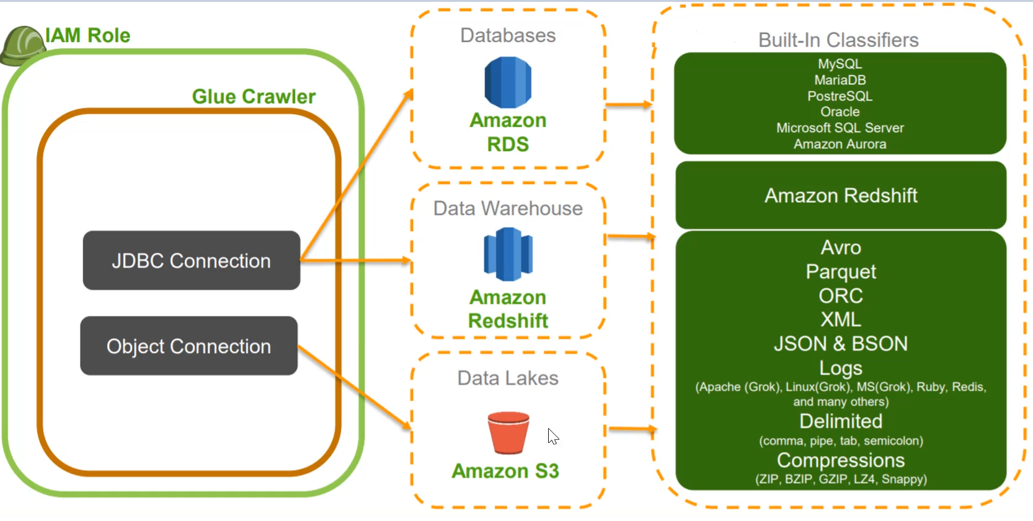
Glue - Crawler

Slide 12
Internal Sharing – Data Flow
- Data flow - OnPrem - Mapping services - AWS - Simple Storage Services - Glue catalog/crawler.
- Athena. - Practice:

Slide 13

Amazon Athena
What’s AWS Athena
AWS Athena Features
Amazon Athena is an interactive query service that makes it easy to analyze data directly in Amazon S3 using standard SQL
Amazon Athena is serverless (no infrastructure, no maintenance…)
Athena scales automatically-running queries in parallel-so results are fast, even with large datasets and complex queries
Athena helps you analyze structured, semi-structured, unstructured data store in S3 (csv, json,avro,parquet,orc…)
No data loading into Athena
Integrates with the AWS Glue Data Catalog
Integrates with AWS QuickSight for data visualization
Generate, explore report with BI tool or SQL client connected with JDBC, ODBC driver
AWS Athena

Slide 14
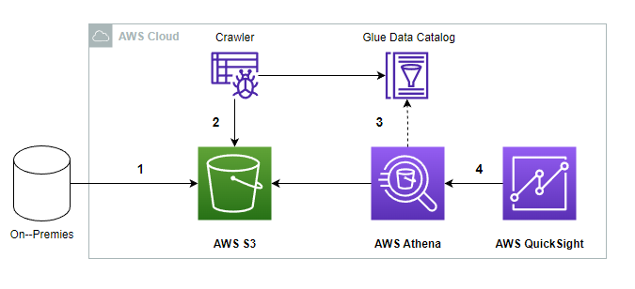
Amazon Athena
Architecture
Pricing
https://aws.amazon.com/athena/pricing/
https://calculator.aws

Slide 15
Internal Sharing – Data Flow
- Data flow - OnPrem - Mapping services - AWS - Simple Storage Services - Glue catalog/crawler.
- Athena. - Cost estimation. - Practice:

Slide 16
Demo
Create S3 Buket
Upload sample data
Crawler
Athena Query

